Slide 1
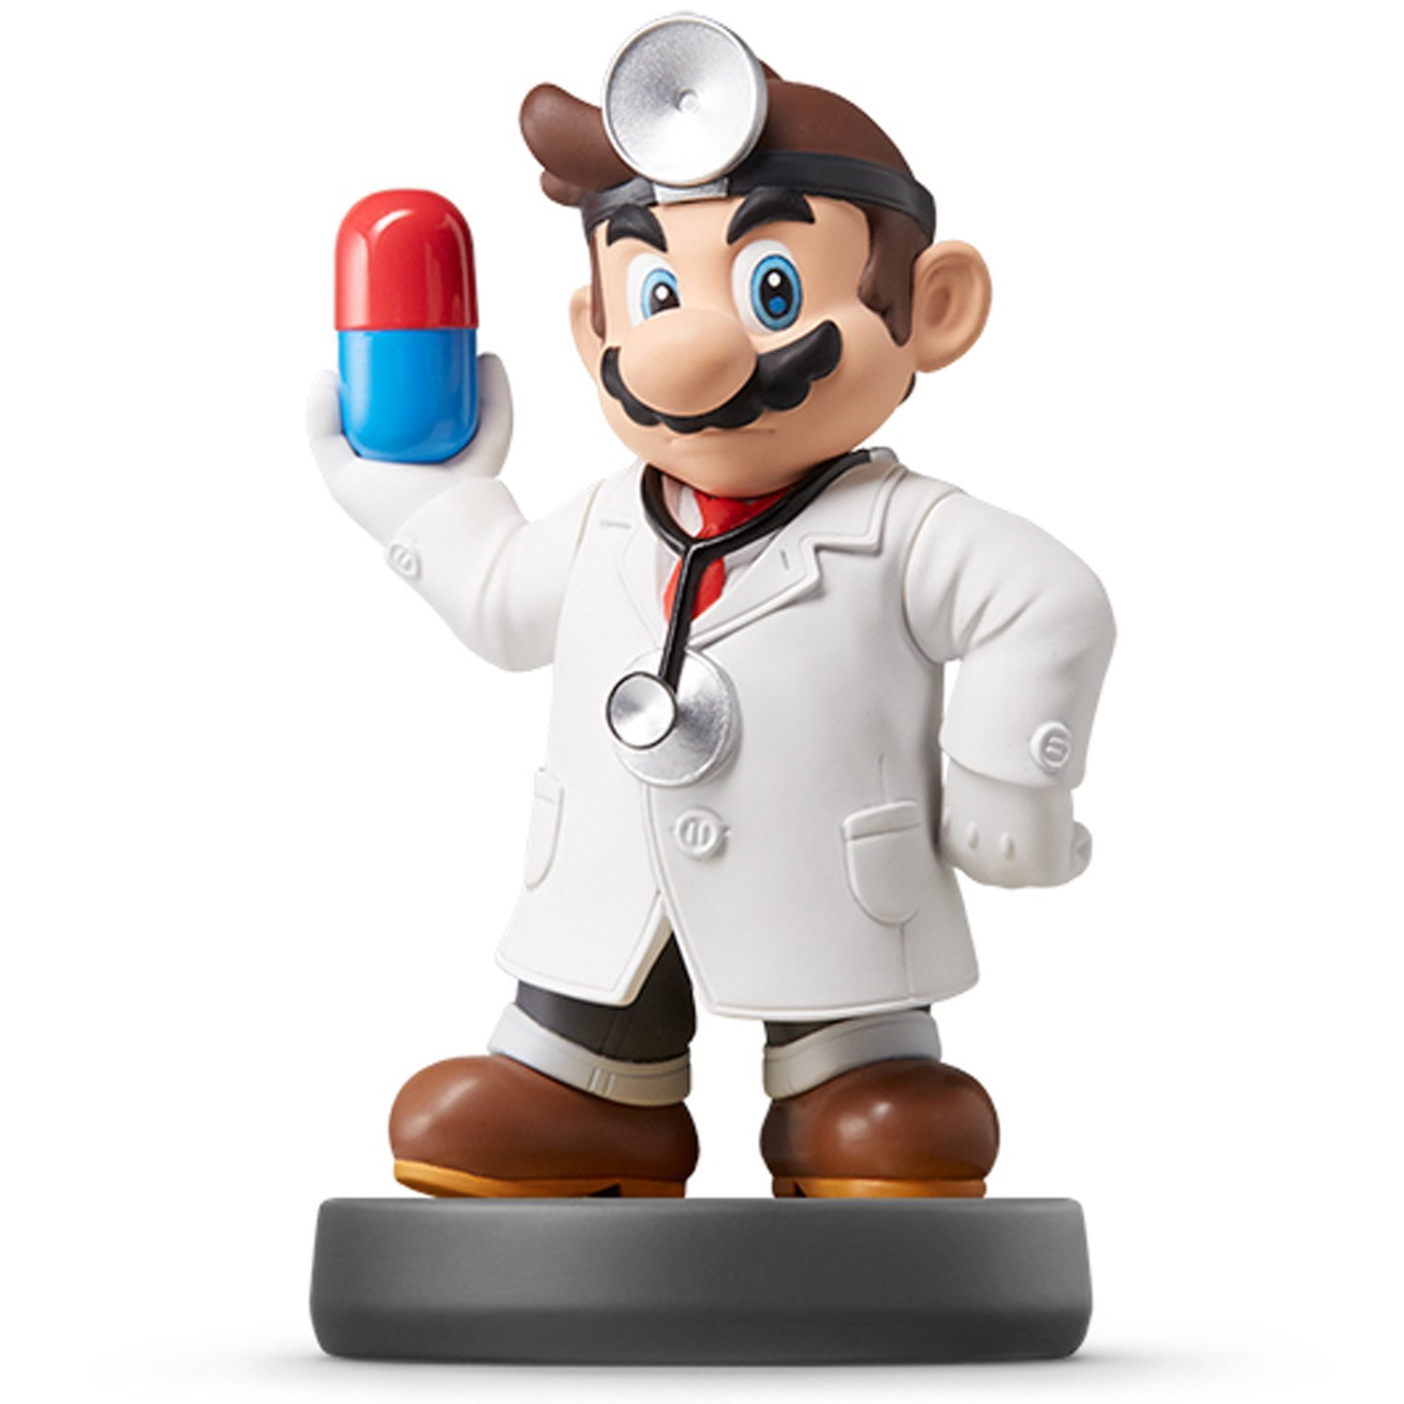
Data Visualization

Slide 2
Who are you?
I Don’t Know
#RollCall

Slide 3
Why are We Here?
To Develop a Personal and Intimate Hate/Love Relationship With R
To Install Some Key R Packages
Tidyverse
Rmarkdown
To Practice Coding via R Scripts
To Learn Elements of ggplot2
To Practice Making Visually Stunning Pictures that Change Lives

Slide 4
What do I Need?
Textbook:
Computer: We will actively use our laptops in every class.
R and RStudio Installed and Operational
High Tolerance for Pain and Agony

Slide 5
What will We Do?
Course Website and Syllabus
In-Class Coding
Weekly Assignments
Labs
Data Analyses
Learn and Use Rmarkdown
Submit Assignments through Sakai
Submit as html Files
Develop Skills that Turn into $$$
Computer Programming
Statistical Analyses
Written and Verbal Communication Skills
Creativity and Innovation
https://supermariogiacomazzo.github.io/STOR320_WEBSITE/

Slide 6
What Should I Do?
Install R on Your Laptop
https://cran.r-project.org/
Install Rstudio Desktop on Your Laptop
https://www.rstudio.com/products/rstudio/#Desktop
Download the Textbooks
R4DS
RP4DS
AoRP
Read the Introduction to R4DS
Practice Programming with R Scripts
10 minutes a day in RP4DS or AoRP
Run Your First RMarkdown File
https://rmarkdown.rstudio.com/lesson-1.html
https://drive.google.com/file/d/1MYjHq9YNxaPAni4Bin8GeEuOT68ilgZW/view?usp=sharing

Slide 7
Closing?
Disperse and Make Reasonable Decisions

